Slide 1
Lower Granite and Little Goose
Fish Ladder Temperature
Improvement Systems
TMT YER
December 7, 2016

Slide 2
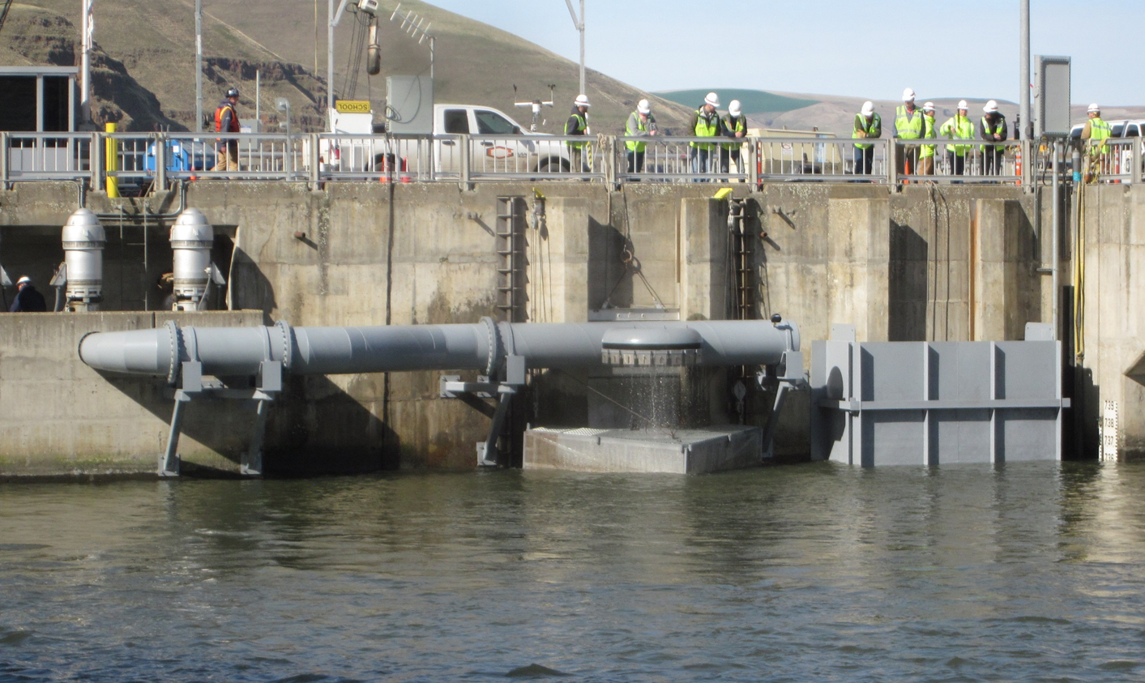
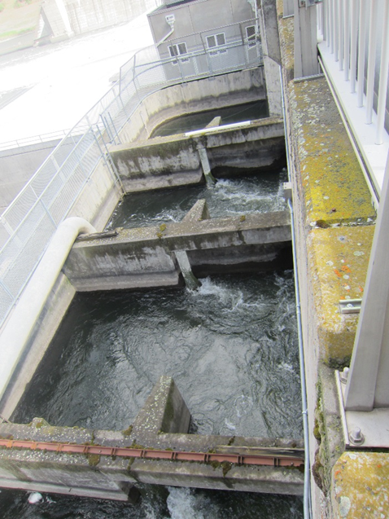
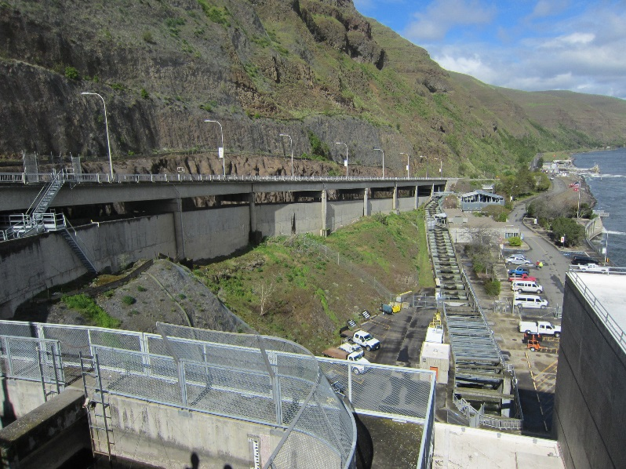
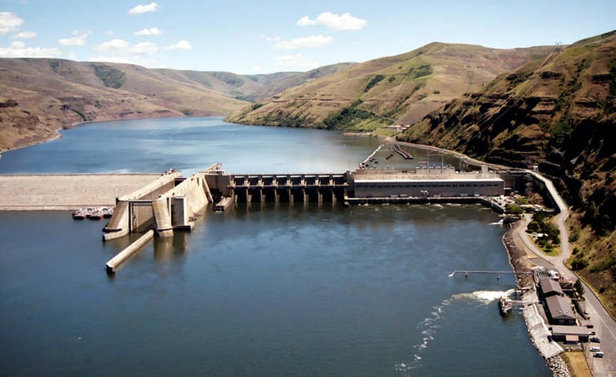
Adult Fish Passage Route

Slide 3
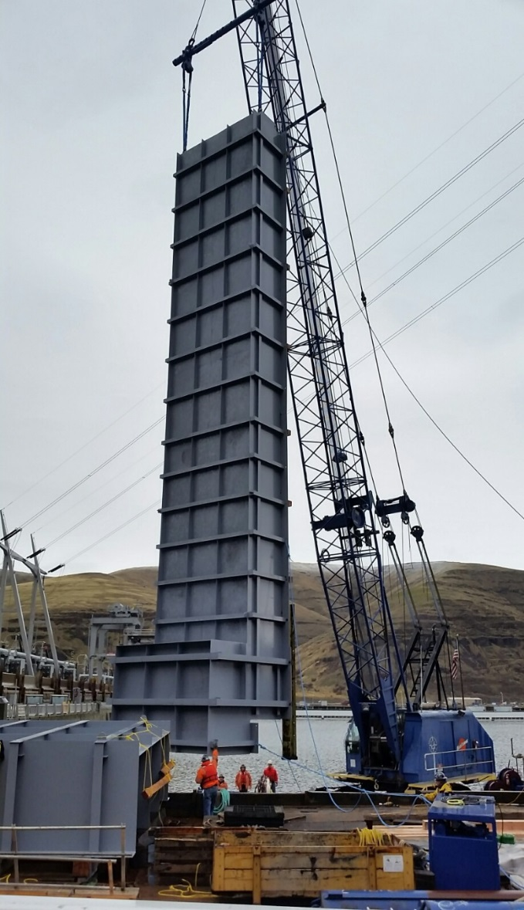
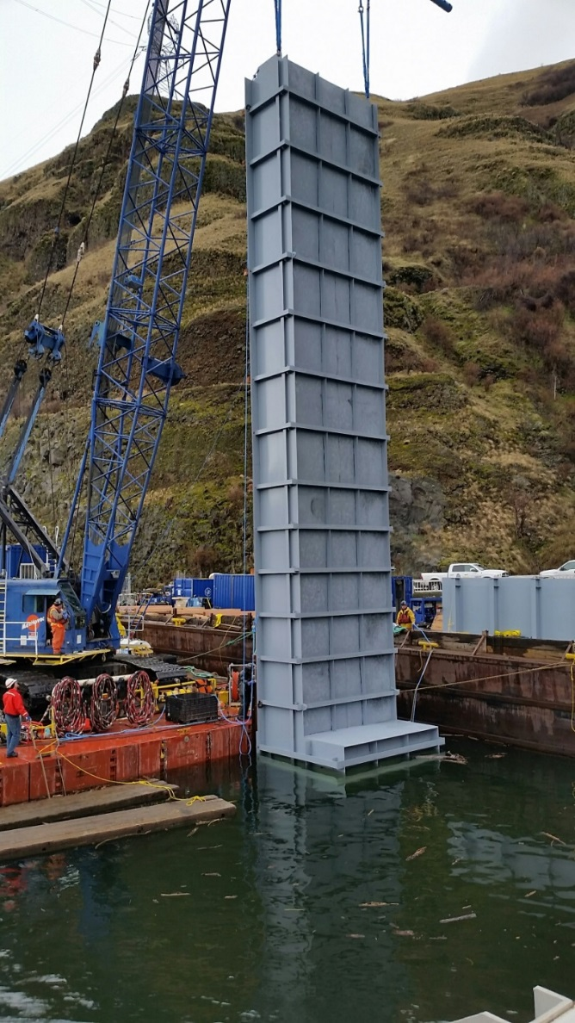
Supplemental Water Intake Chimney – 70 ft.

Slide 5
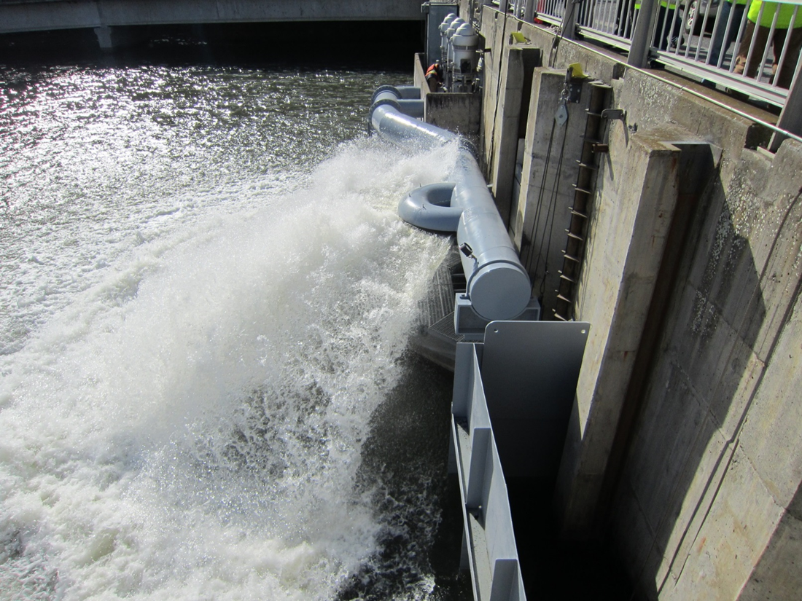

Slide 6
2016
Turned ON : June 9
Turned OFF : September 8
No Passage Issues due to Water Temperature
Monitoring performed to understand fish distribution of fish exiting the ladder (ARIS acoustic camera)
-Sockeye appeared to stay within similar depth upon ladder exit moving out into forebay
-Fall Chinook appeared to move deeper upon exit from the ladder

Slide 7
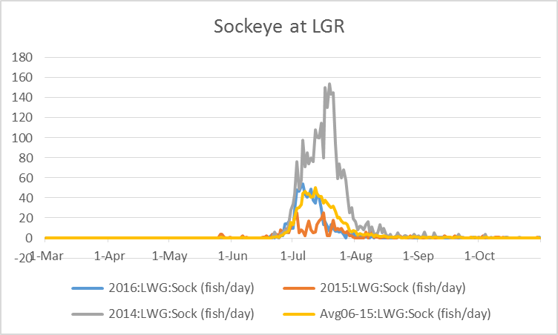

Slide 8
Justification for similar project at LGS
-Temperature blockage observed during 2015 for upstream bound sockeye
-Below 80 ft there is a cooler water layer that can provide a 2-4 degrees C benefit
-Similar total flow into ladder exit as LGR, with 25 cfs gravity fed from forebay into the control section of the fish ladder

Slide 9
PROBLEM in 2015 LGS
Flow (Kcfs)
Sockeye
-Lower peak annual discharge
-Narrower period of adult sockeye peak movement with periods of delayed passage
- Higher water temperatures during May, June
Notes:
Extreme warm temperatures in early July caused both delay and cessation of upstream migration for sockeye. This was the first time that a migration blockage for sockeye occurred at Little Goose. Discharges during May – July were well below the 10 yr average which has an influence on many elements of water quality. Water temperatures at 10 meters were noticeably elevated over the previous 10 yr average. Regional fish managers have requested Corps to install a deep forebay pumping system similar to Lower Granite to reduce the possibility of reoccurrence of these circumstances. Corps is reviewing data to understand if a benefit would be gained by installing forebay pumps and the temporal period of the resultant water temperature reduction.

Slide 10
HYPOTHESIS AFTER 2015
The temperature of water approaching Little Goose is very correlated with temperatures in the LGR dam tailrace which are regulated with flow augmentation from DWR dam
-IF 25 cfs of water from 80 ft deep in the forebay had been added to the ladder exit area in 2015:
1. there would have been a reduction from 32% to 16% for the amount of time water temperatures would have exceeded 68°F
2. there would have been no periods when water temperatures exceeded 72°F
3. there would have been no average hourly temperature differentials > 4°F

Slide 11
Little Goose 2016 Temporary Cooling Pump Operation
Pumps Turned ON : July 1
Pumps Turned OFF: September 9
Hobo brand thermistors were used to monitor the ladder exit area in 2016 (Hourly readings)
Data was uploaded weekly to the FPC website

Slide 12
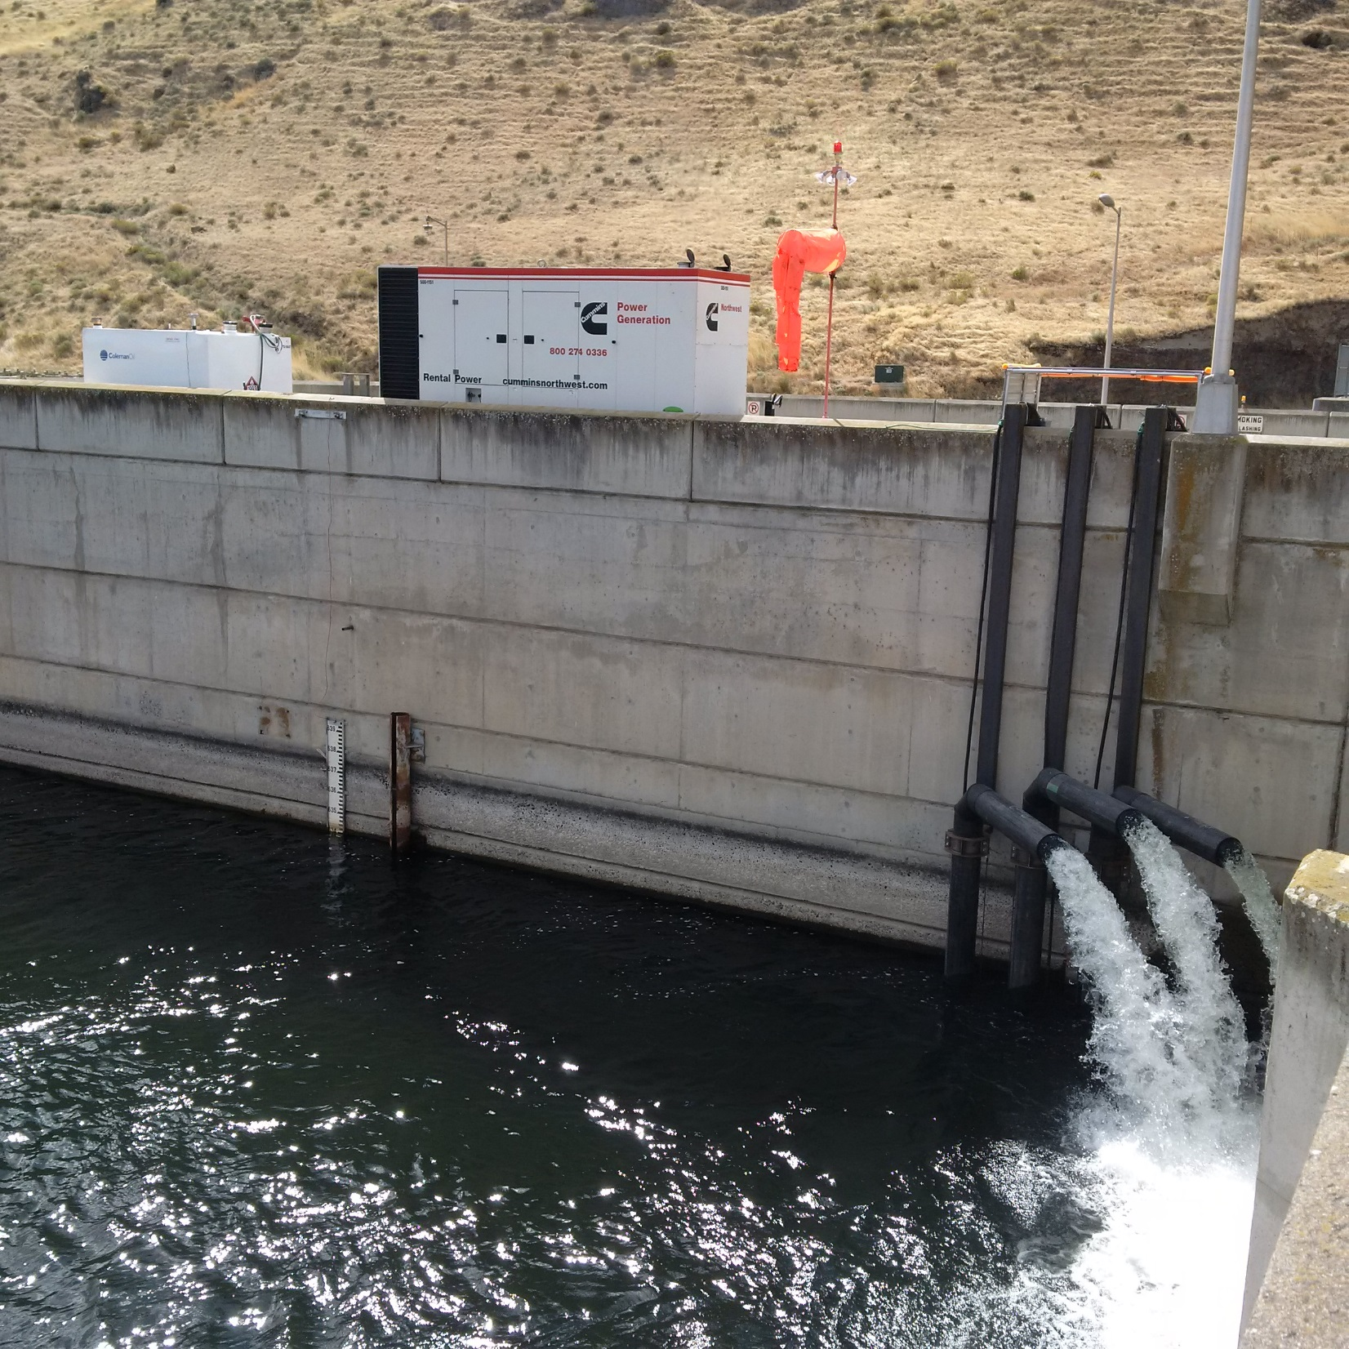

Slide 13
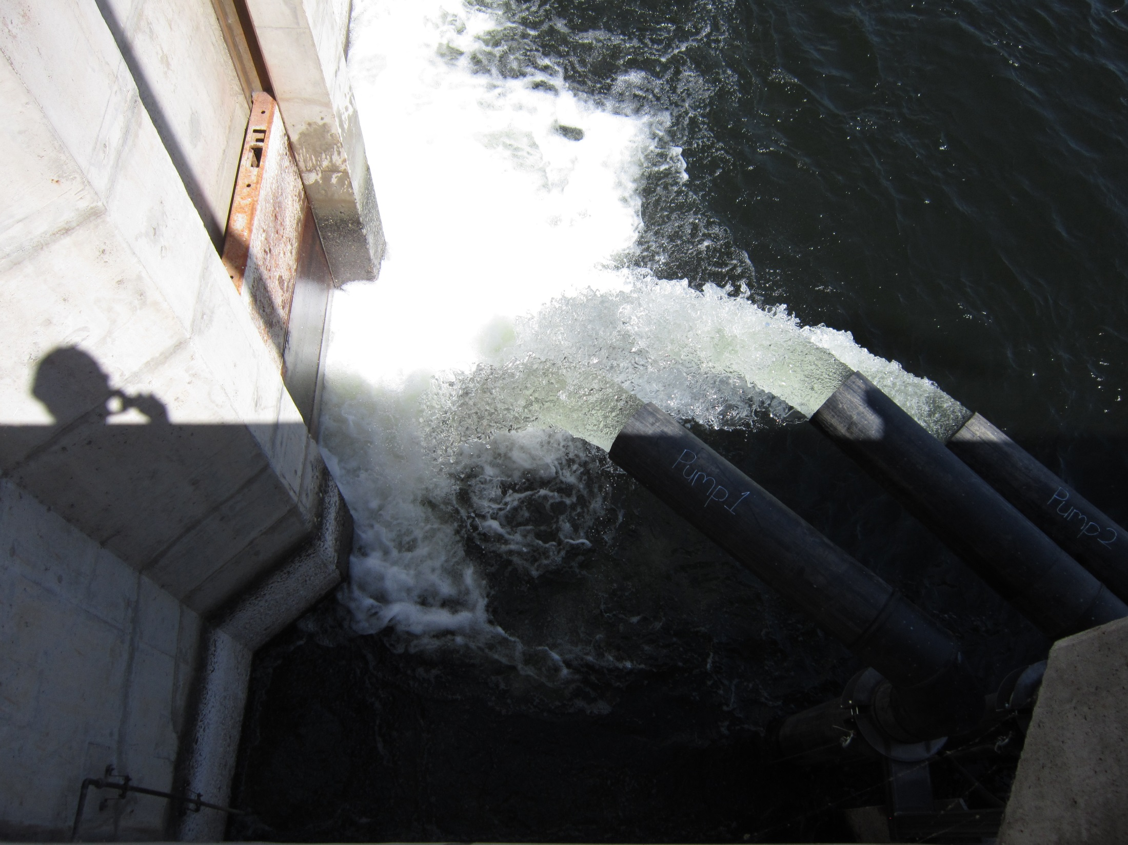

Slide 14
2016 Forebay Temperature Possible Benefits
Date of first day avg water temp exceeded 68°F = July 4
Date of last day avg water temp exceeded 68°F = August 29
Number of days daily avg water temps exceeded 68°= 15 days
Maximum daily temperature was 69.1 on August 4
VERSUS 2015
Date of first day avg water temp exceeded 68°F = June 20
Date of last day avg water temp exceeded 68°F = Sept 2
Number of days daily avg water temps exceeded 68°= 58 days
Maximum daily temperature was 71.9 on July 14

Slide 15
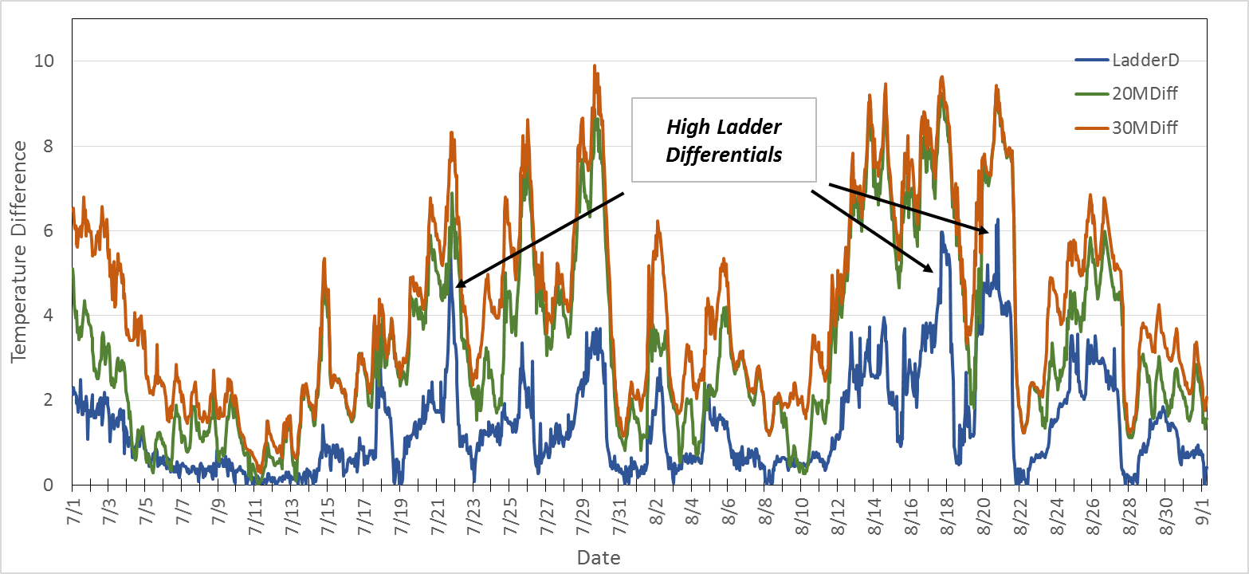
Little Goose 2016
Because differential was not a primary determinant for successful passage during 2016, perhaps differential becomes most important the greater you exceed a species preferred water temperature threshold

Slide 16
CAVEATS
Rental pumps in 2016 could operate no deeper than 66 ft in the forebay
Permanent system will better perform due to depth of pump at 80 ft will reach the coolest forebay water
Volume of permanent system will be same as temporary (25 cfs /~12,000 gallons)

Slide 17
2018 Permanent System
Installation in January 2018
For 2017 another temporary system
Utilize new permanent axial pump at 80 ft depth
Utilize a generator again to provide power for the pump

Slide 18
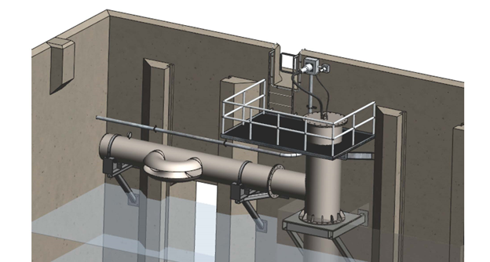

Slide 19
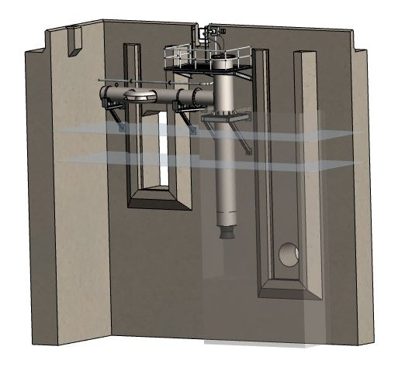

Slide 20

QUESTIONS ??

Slide 22
